Slide 1

CSCI 4237
Software Design for Handheld Devices
Lecture 10 - Firebase: Authentication & Database
Mike Cobb

Slide 2
Announcements
Final Exam Schedule Posted

Slide 3
Grading update
Quiz 2- Complete. Very good.
Project 1- Working on it.

Slide 4
Last Time
Team Game Development with Dice
Missing some individual in-class exercise submissions
Missing some project 1 check-in
Missing some project turn-ins

Slide 5
Today
Firebase
Authentication
Realtime Database (probably next week)
Crashalytics/analytics
Project 2
Notes:
Notes:
Slides, background of Firebase
Demo what Firebase? Jeopardy and golf
Firebase ADK Authentication
Console.firebase.google.com
Don’t add the json file to your project.

Slide 6
Project 1
Team Discussion
Project 1
1 or 2 highlights per table

Slide 7
Demo of what we’re going to be building...
We’re going to see how to implement “real” user registration & login.

Slide 8
Demo of what we’re going to be building...
We’re also going to see how we might host our own “Yelp” comments in a cloud database.
Our version “Yelp” will be retrieved based on what state your in (e.g. all of Virginia will see the same content).

Slide 9
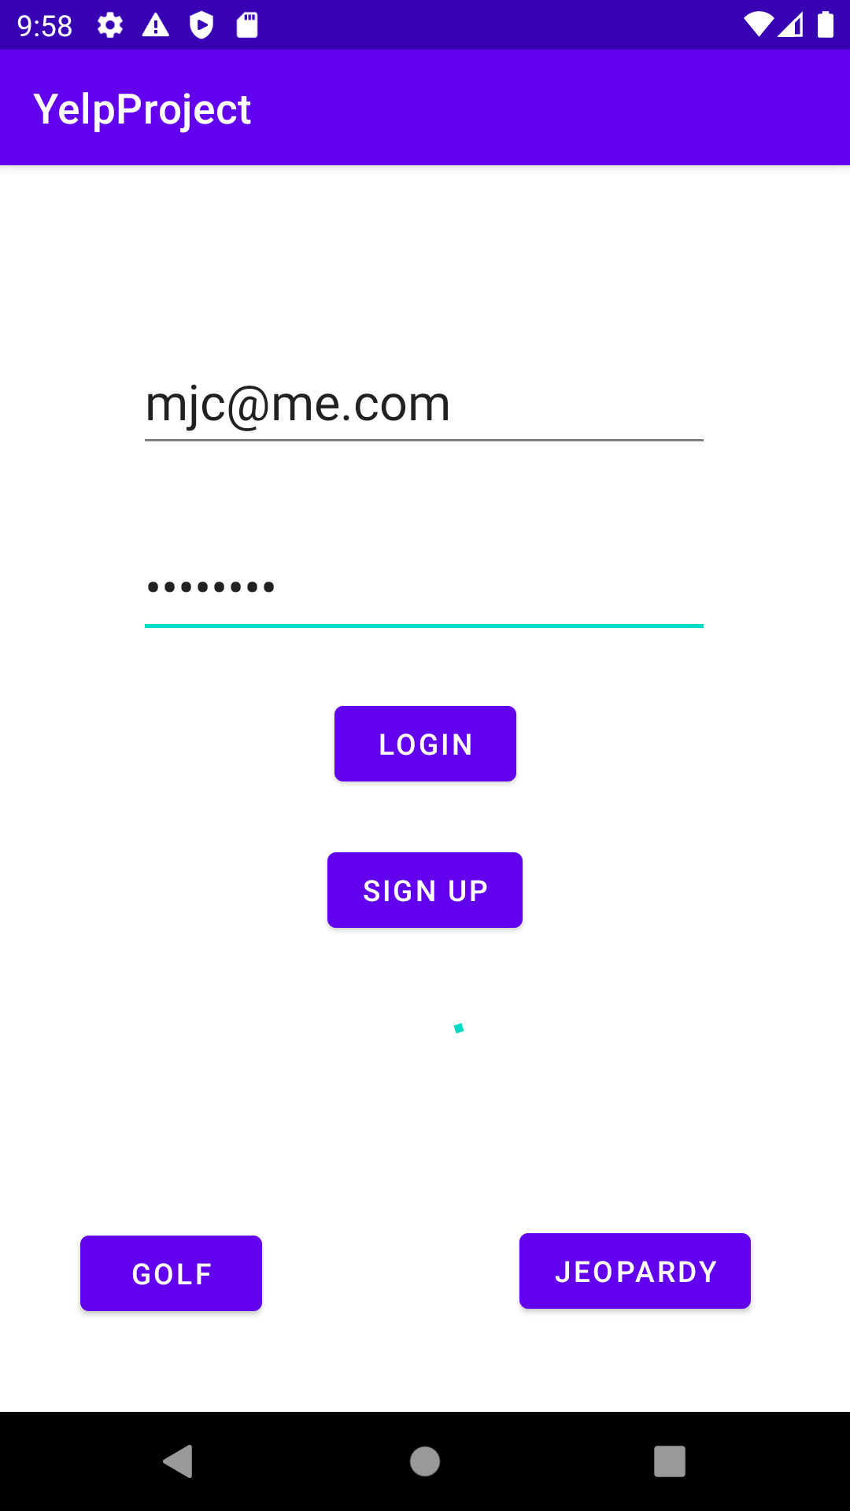
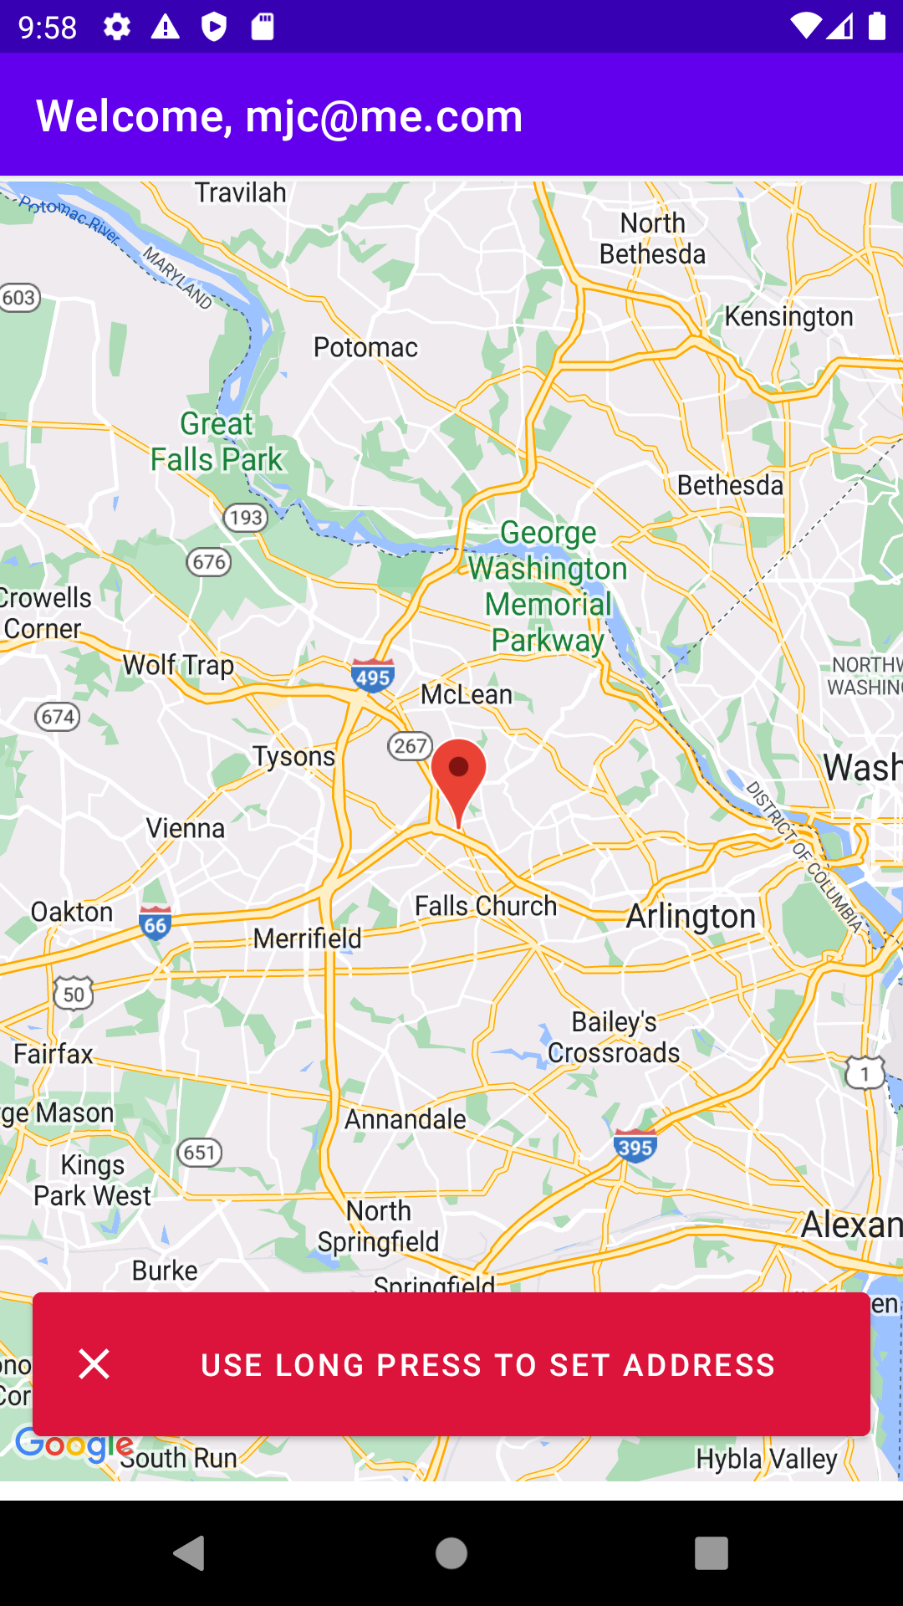
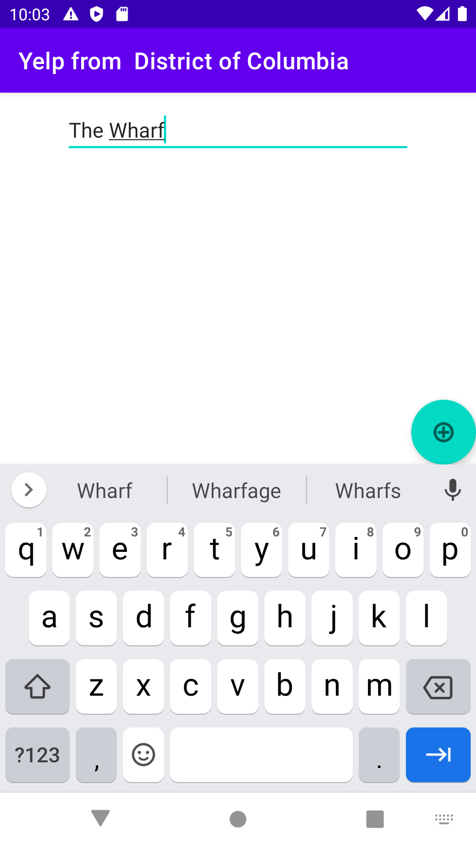
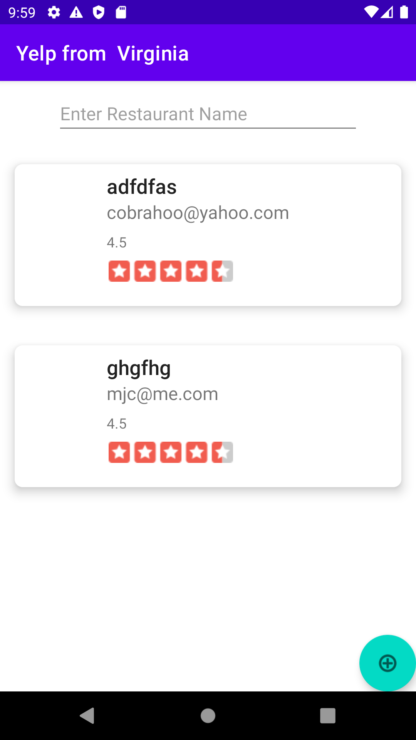
Demo of what we’re going to be building...

Slide 10
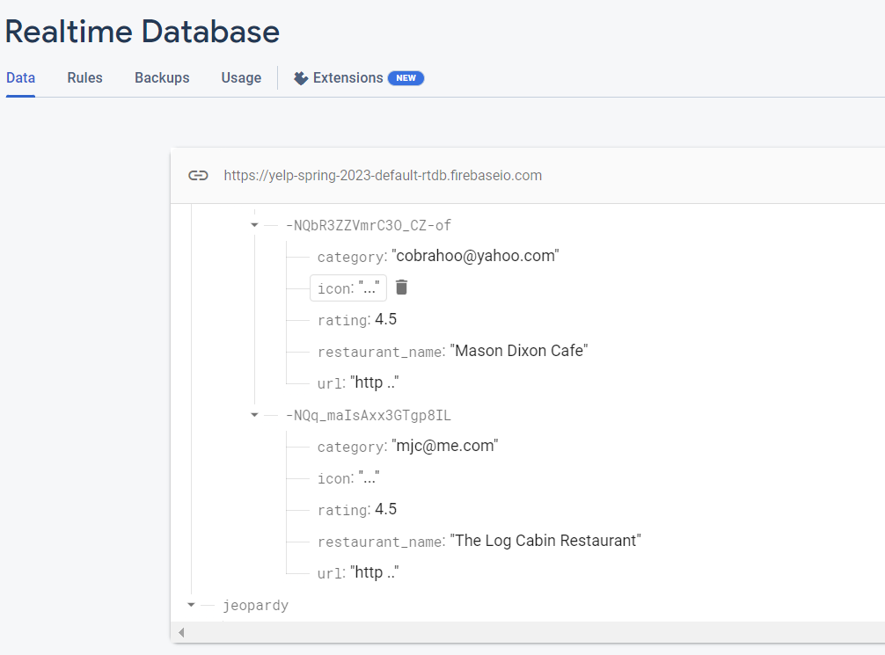
Demo of what we’re going to be building...

Slide 11
Demo of what we’re going to be building...
Nearly all the functionality is implemented in about 100 lines of code, thanks to the Firebase SDK.

Slide 12
Demo of what we’re going to be building...
In short, we’ll be adding:
User authentication (Sign In / Sign Up)
Simple cloud data storage
We’ll see how we can write Kotlin data classes (e.g. our “yelpBusiness” class) to a cloud DB.

Slide 13
Firebase

Slide 14

A Google-owned collection of SDKs to enable:

Slide 15
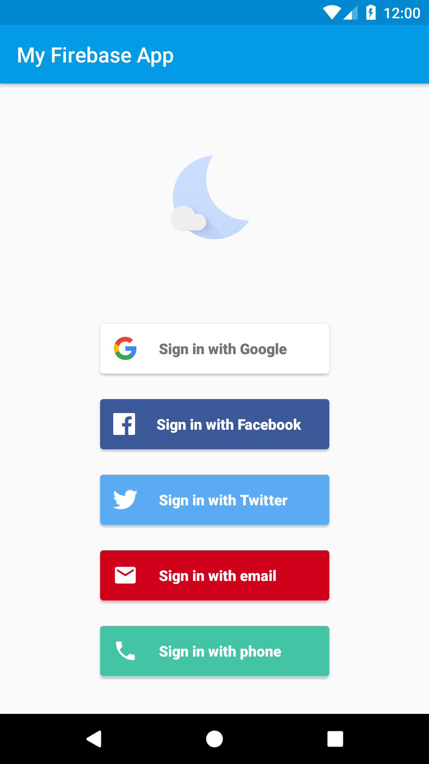
A Google-owned collection of SDKs to enable:
Auth & Sign Up

Slide 16
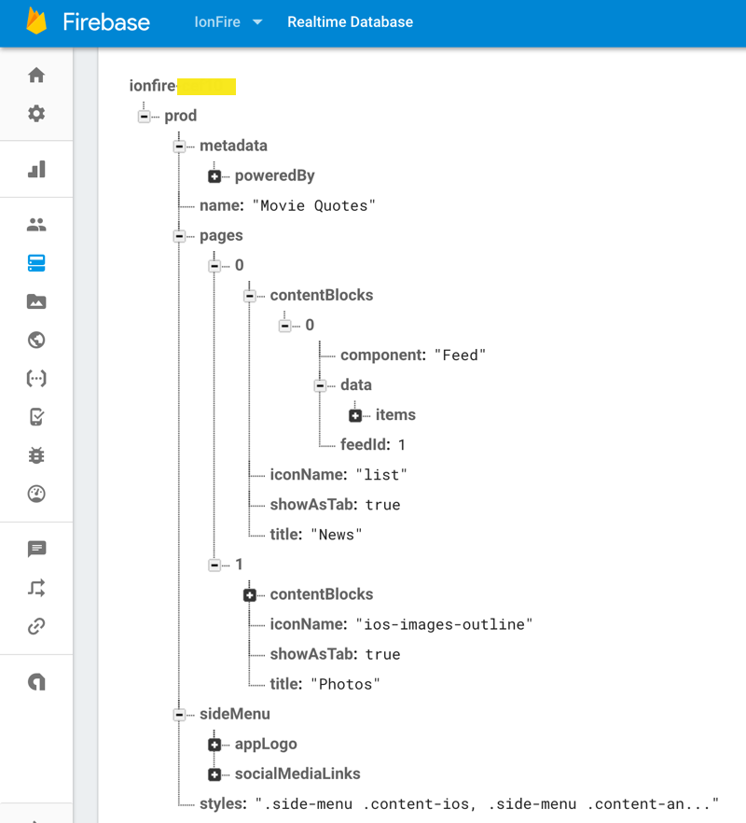
A Google-owned collection of SDKs to enable:
Auth & Sign Up
Realtime Database

Slide 17
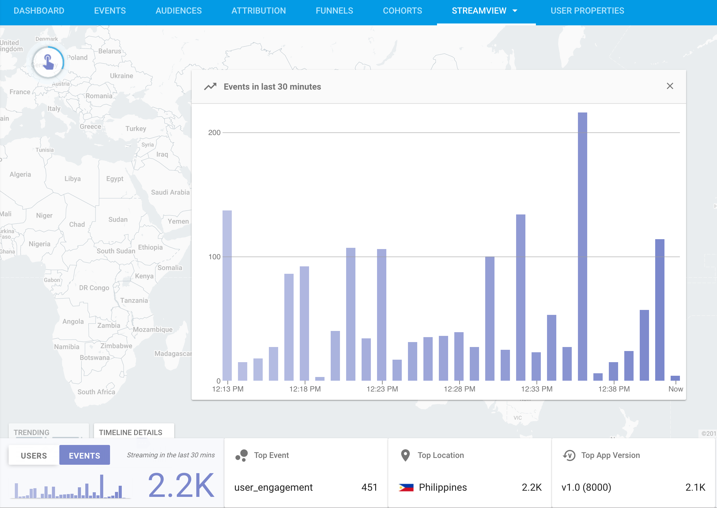
A Google-owned collection of SDKs to enable:
Auth & Sign Up
Realtime Database
Analytics

Slide 18
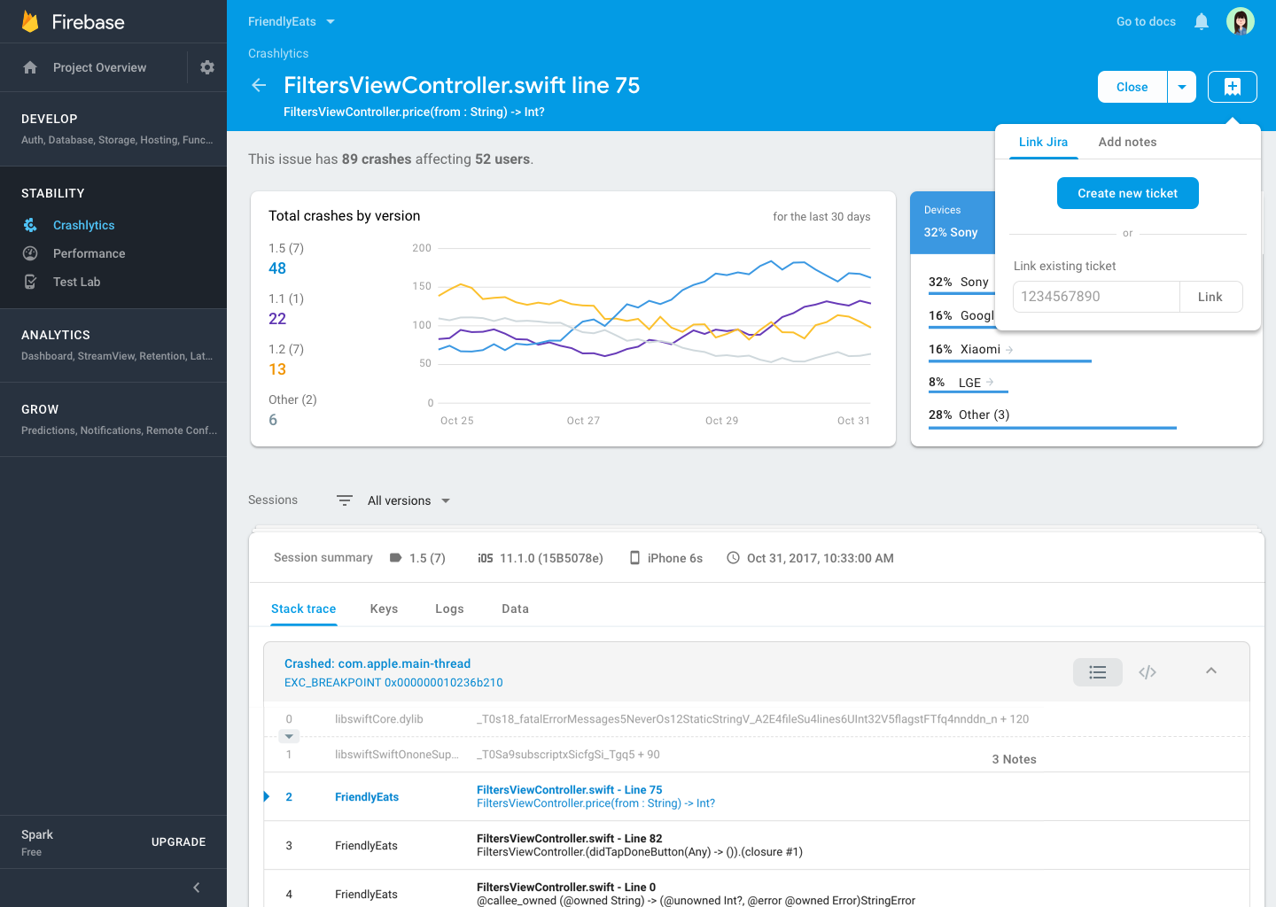
A Google-owned collection of SDKs to enable:
Auth & Sign Up
Realtime Database
Analytics
Crash Reporting

Slide 19
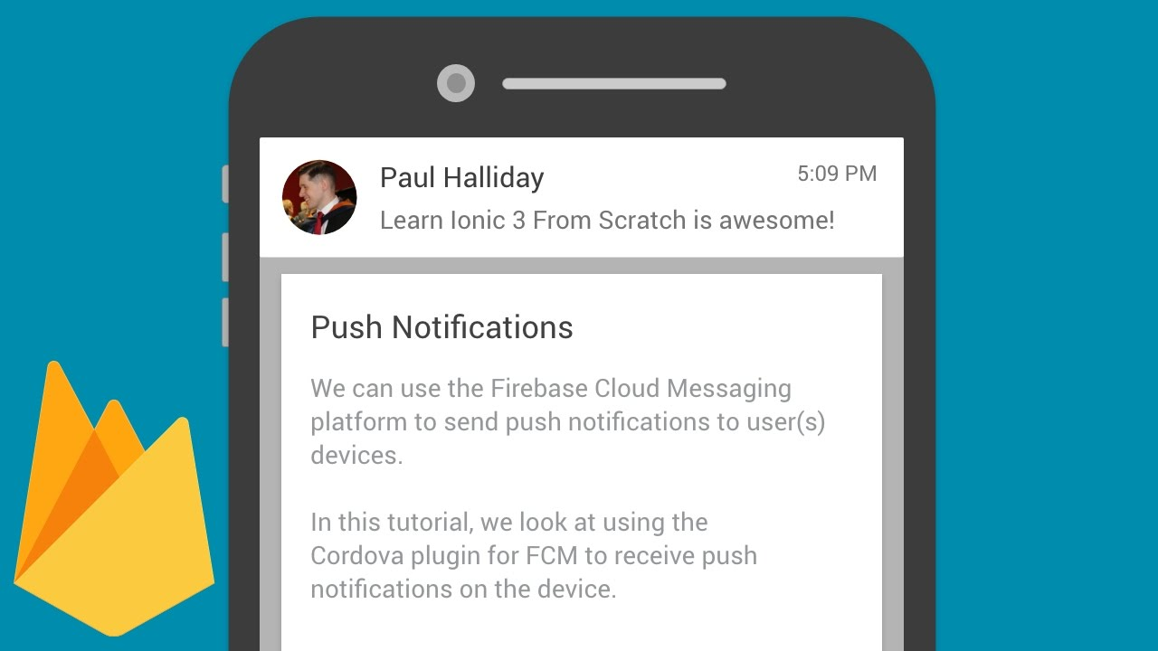
A Google-owned collection of SDKs to enable:
Auth & Sign Up
Realtime Database
Analytics
Crash Reporting
Cloud Messaging

Slide 20
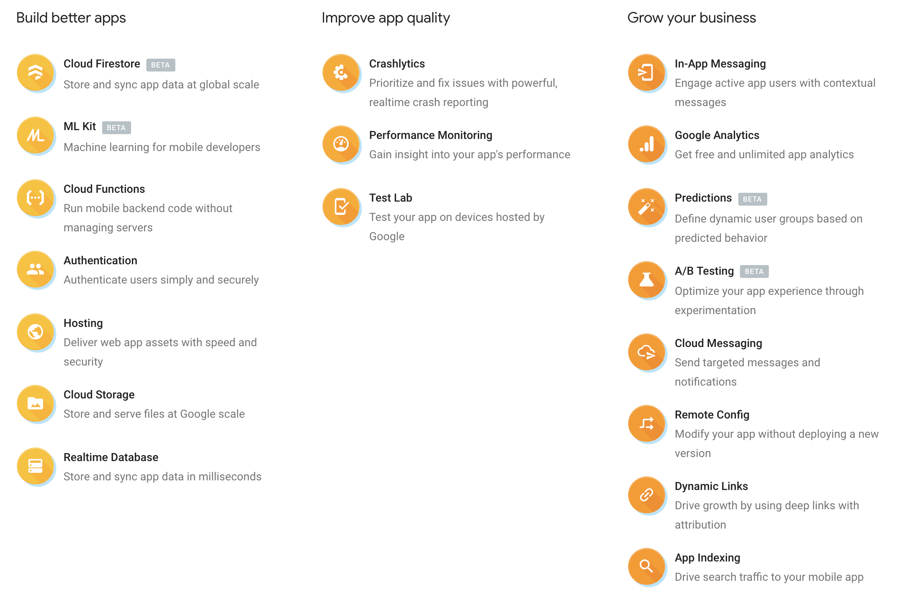

Slide 21
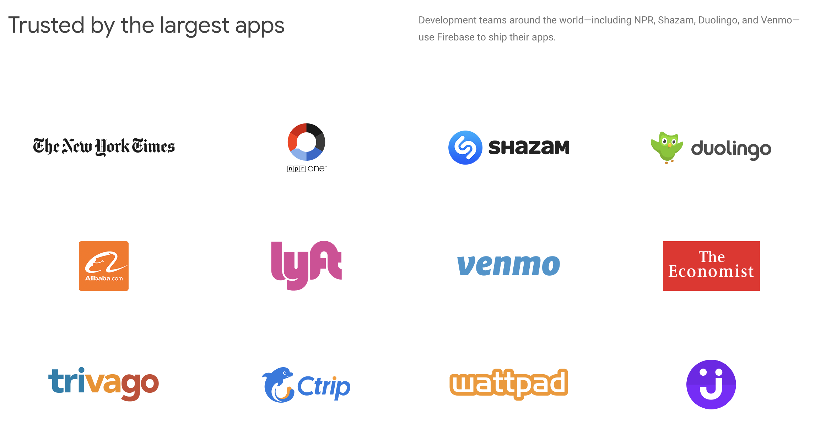

Slide 22
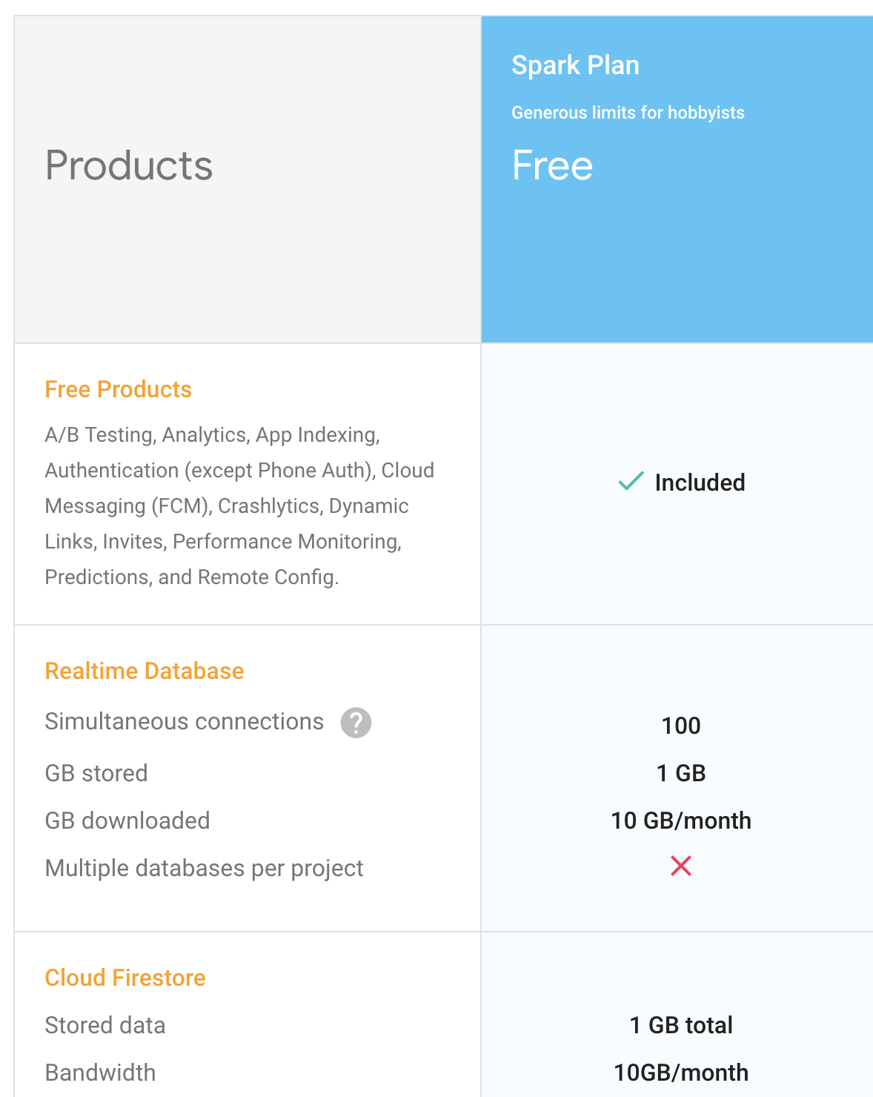
Many features are completely free-to-use and some are free for development or very small apps.

Slide 23
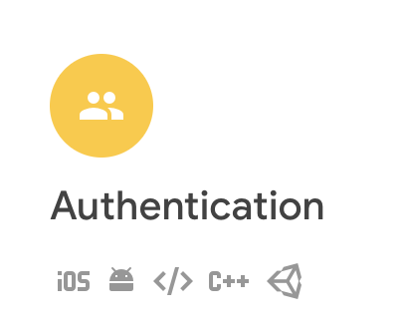
Many of their products are also cross-platform!

Slide 24
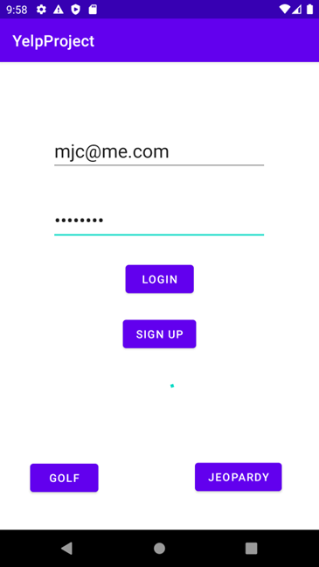

Today
Today we’re going to learn the Authentication and (if time allows) Realtime DB components of Firebase.

Slide 25
Firebase Authentication

Slide 26
Firebase Authentication
Firebase Authentication is an SDK that gives users the ability to log in with:
Email / Phone / Password
Google
Facebook
Twitter
GitHub

Slide 27
Firebase Authentication
Two flavors:
FirebaseUI Auth - all-in-one solution (includes UI and networking code).

Slide 28

Firebase Authentication
Firebase SDK Authentication - you write the UI & code yourself to login & sign up.
Firebase takes care of credential storage and validation.

Slide 29
Firebase SDK Authentication
We already have a “login” screen for our Yelp app and it’s easy to update it to do Sign Up too.
We’ll learn to use the SDK to do an actual login or sign up.

Slide 30
Setting Up a Firebase Project
The following steps are adapted from the official integration docs.

Slide 31
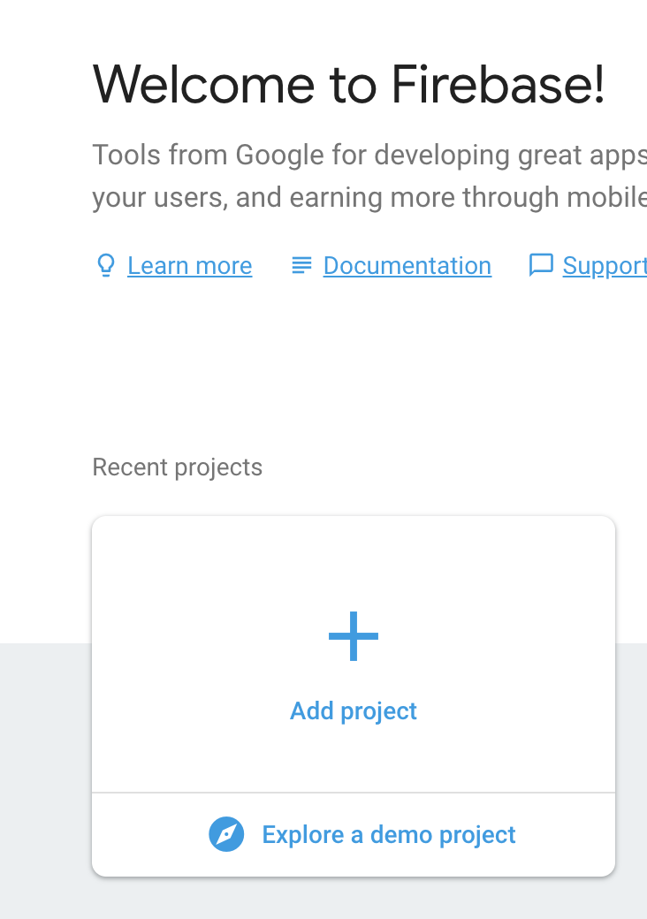
Setting Up a Firebase Project
Similar to the Google Console, we need to create a Firebase project & get API keys.
https://console.firebase.google.com/

Slide 32
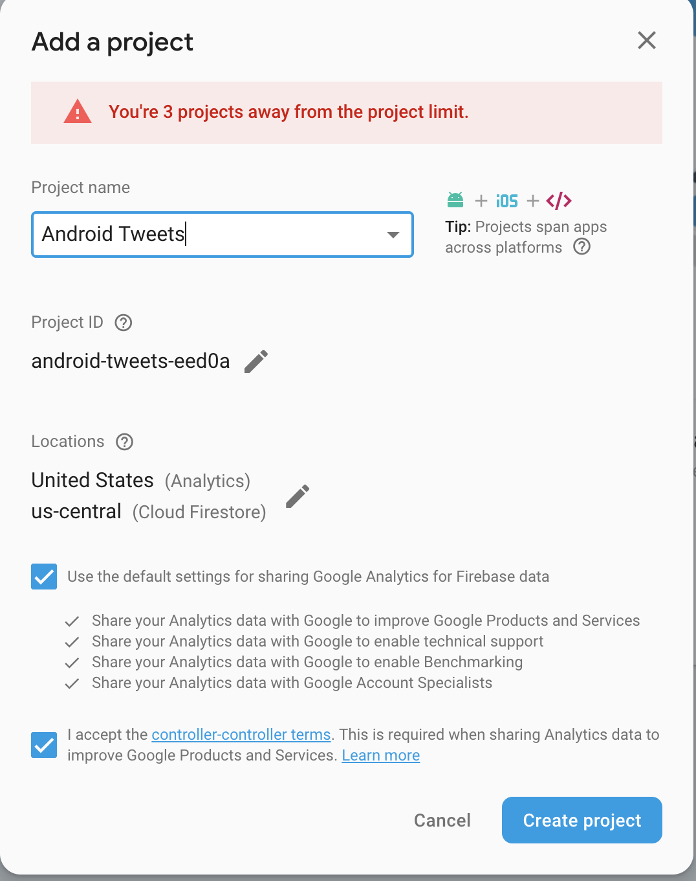
Setting Up a Firebase Project
Similar to the Google Console, we need to create a Firebase project & get API keys.
https://console.firebase.google.com/

Slide 33
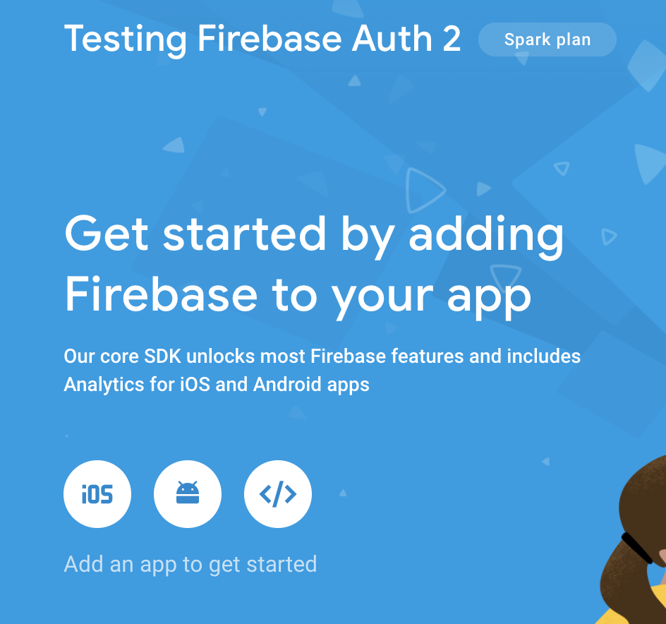
Setting Up a Firebase Project
Follow the steps to set up for an Android application.

Slide 34
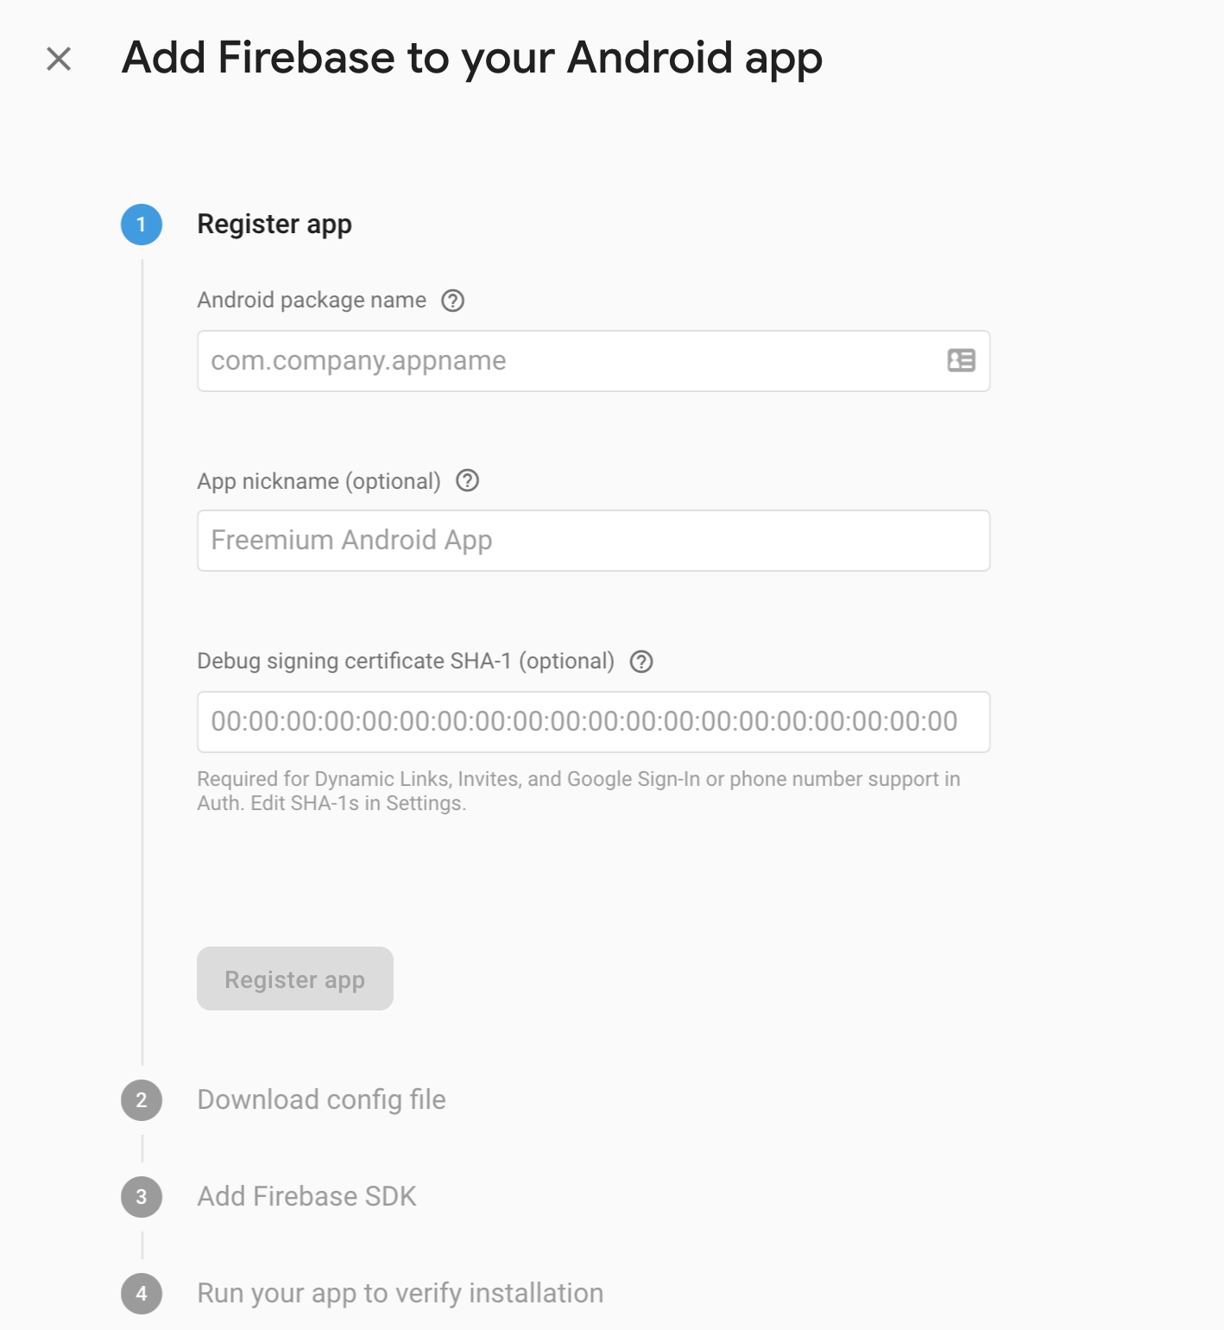
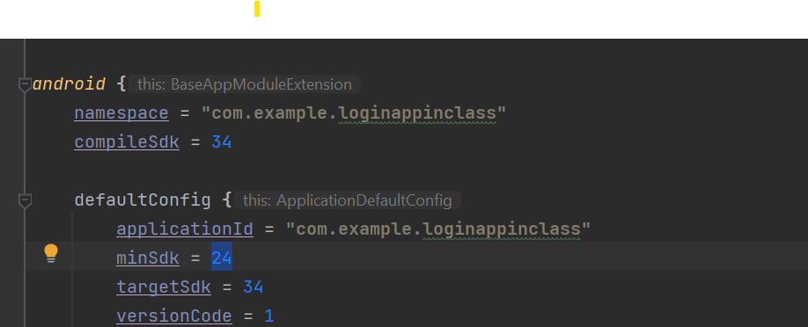
Setting Up a Firebase Project
Follow the steps to set up for an Android application.
For the package name - grab it from the top of your Appnbuild.gradle file.
Don’t need nickname / SHA-1 for our usage.

Slide 35
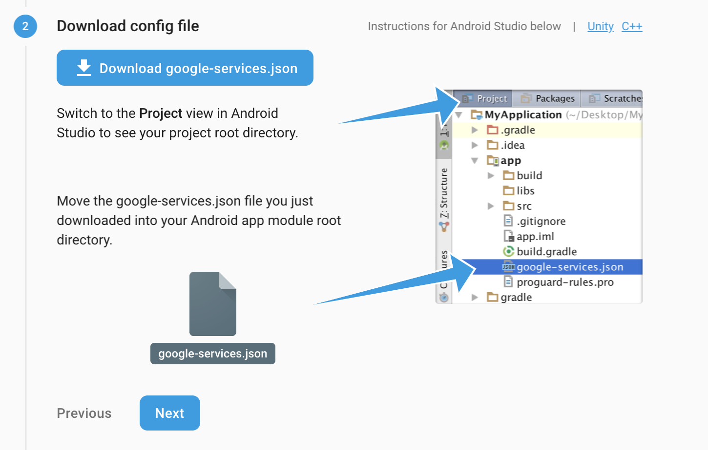
Setting Up a Firebase Project
Follow the steps to set up for an Android application.
Download and place the .json file exactly where it tells you.
The JSON file contains your API Keys and Firebase will automatically look for it.

Slide 36
Setting Up a Firebase Project
Add to your project-level build.gradle: classpath 'com.google.gms:google-services:4.4.0'
id("com.google.gms.google-services") version "4.4.0" apply false

Slide 37
Setting Up a Firebase Project
Add to your app-level build.gradle, at the top with the other plugins
plugins {
// ...
id 'com.google.gms.google-services'
}

Slide 38
Setting Up a Firebase Project
This is a build system (Gradle) plugin that will be used to read our Firebase API keys from the JSON file we downloaded and do some basic configuration of the SDK for us.
plugins {
// ...
id 'com.google.gms.google-services'
}

Slide 39
Setting Up a Firebase Project
Add to your app-level build.gradle:
// This is a "bill-of-materials" (BoM)
// It basically allows us to specify one version (28.4.2) that will be used across all
// Firebase SDKs we add to our app, in order to ensure compatibility between them all.
implementation platform('com.google.firebase:firebase-bom:32.4.0')
// Declare the dependency for the Firebase Authentication library
// When using the BoM, you don't specify versions in Firebase library dependencies
implementation 'com.google.firebase:firebase-auth-ktx'
Notes:
https://firebase.google.com/docs/android/learn-more#bom

Slide 40
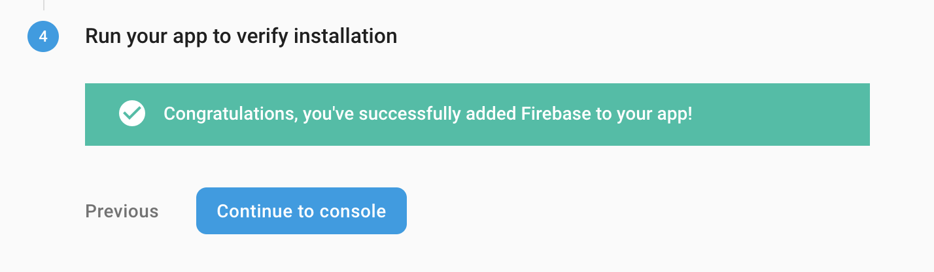
Setting Up a Firebase Project
Follow the steps to set up for an Android application.
Make sure you run the app at least once after performing the steps.
Sometimes this doesn’t always “work” right away...

Slide 41
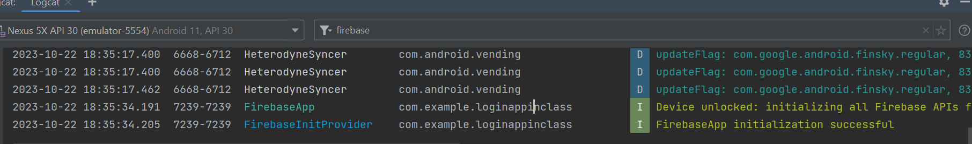
Setting Up a Firebase Project
Follow the steps to set up for an Android application.
Make sure you run the app at least once after performing the steps.
You can also filter the logs for “Firebase” and see if the initialization was successful.

Slide 42
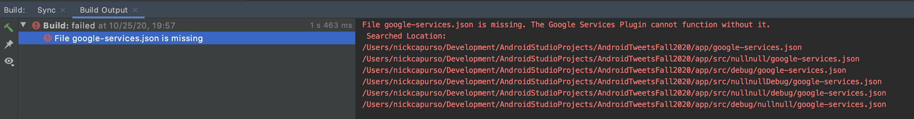
Setting Up a Firebase Project
This error usually means your JSON file is in the wrong location.

Slide 43
Enabling Authentication
You have to explicitly enable Authentication for the methods you want.
We’ll do Email / Password for today.

Slide 44
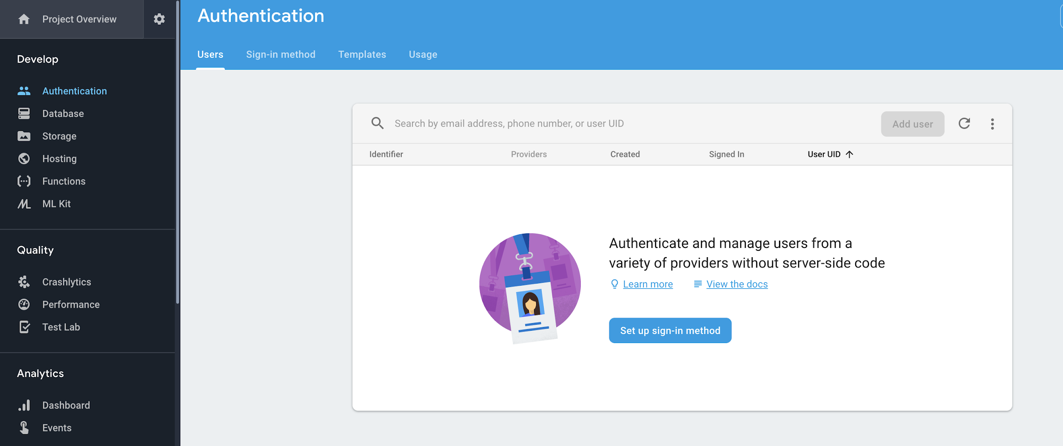
Enabling Authentication

Slide 45
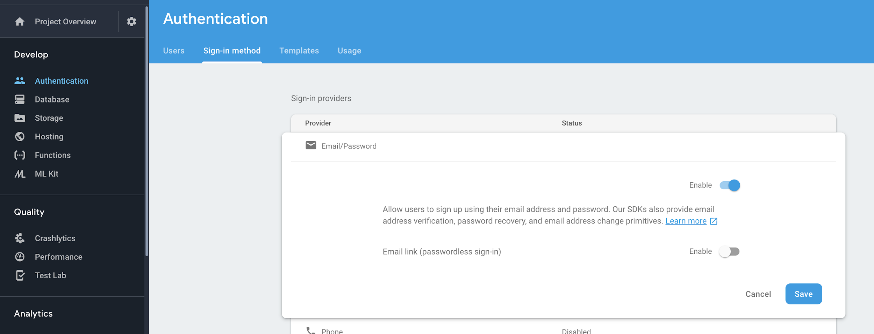
Enabling Authentication

Slide 46
Enabling Authentication
We won’t use it today -- but you can also configure email templates (e.g. for email verification, password reset, etc.).
You can trigger these events from Kotlin code too!

Slide 47
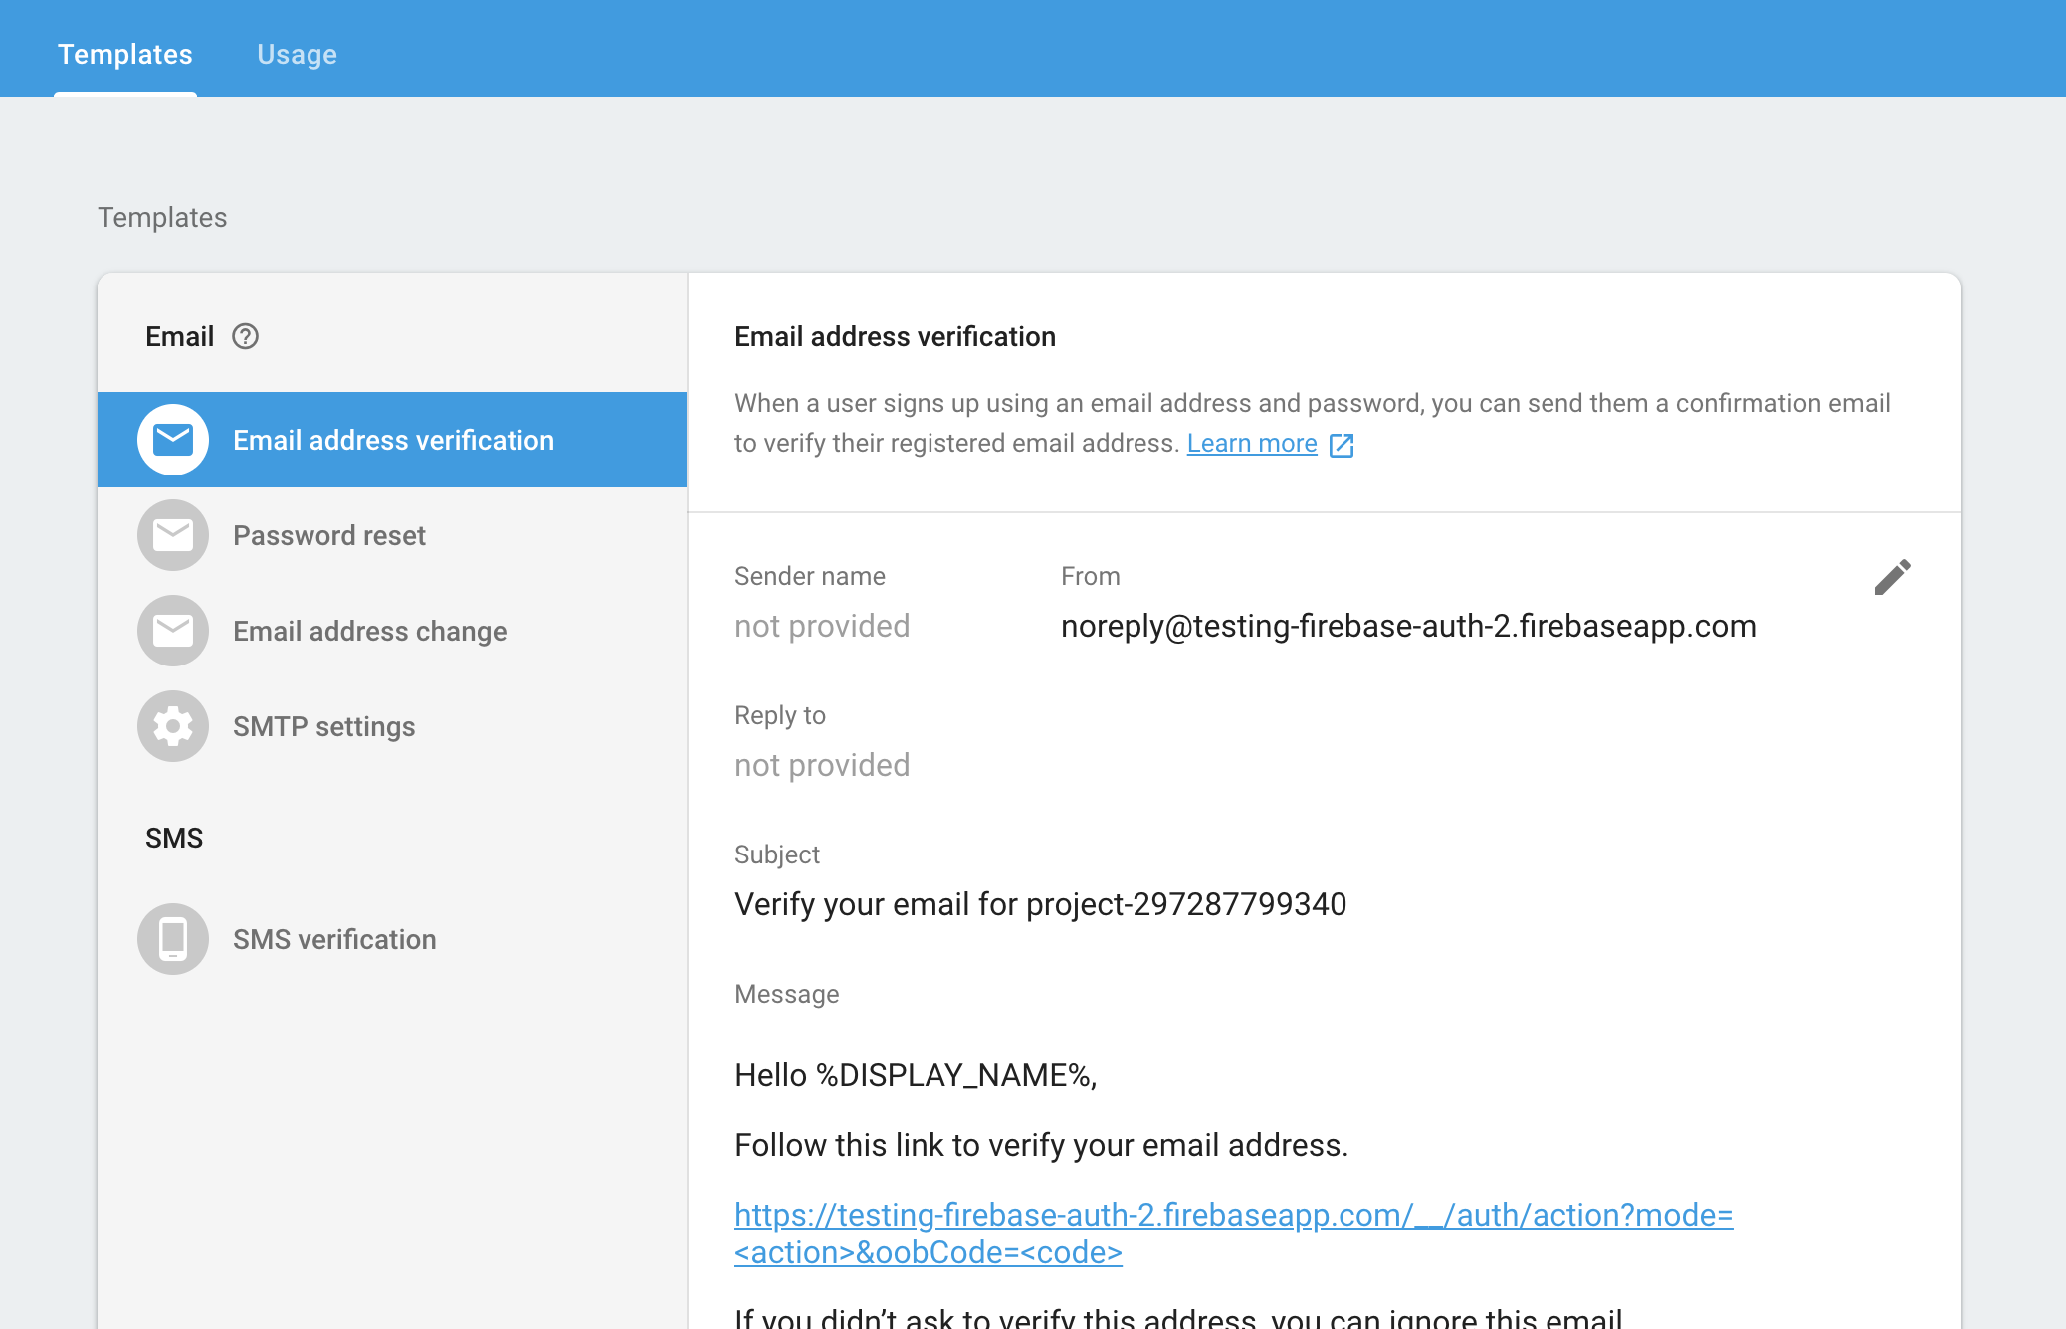
Enabling Authentication

Slide 48
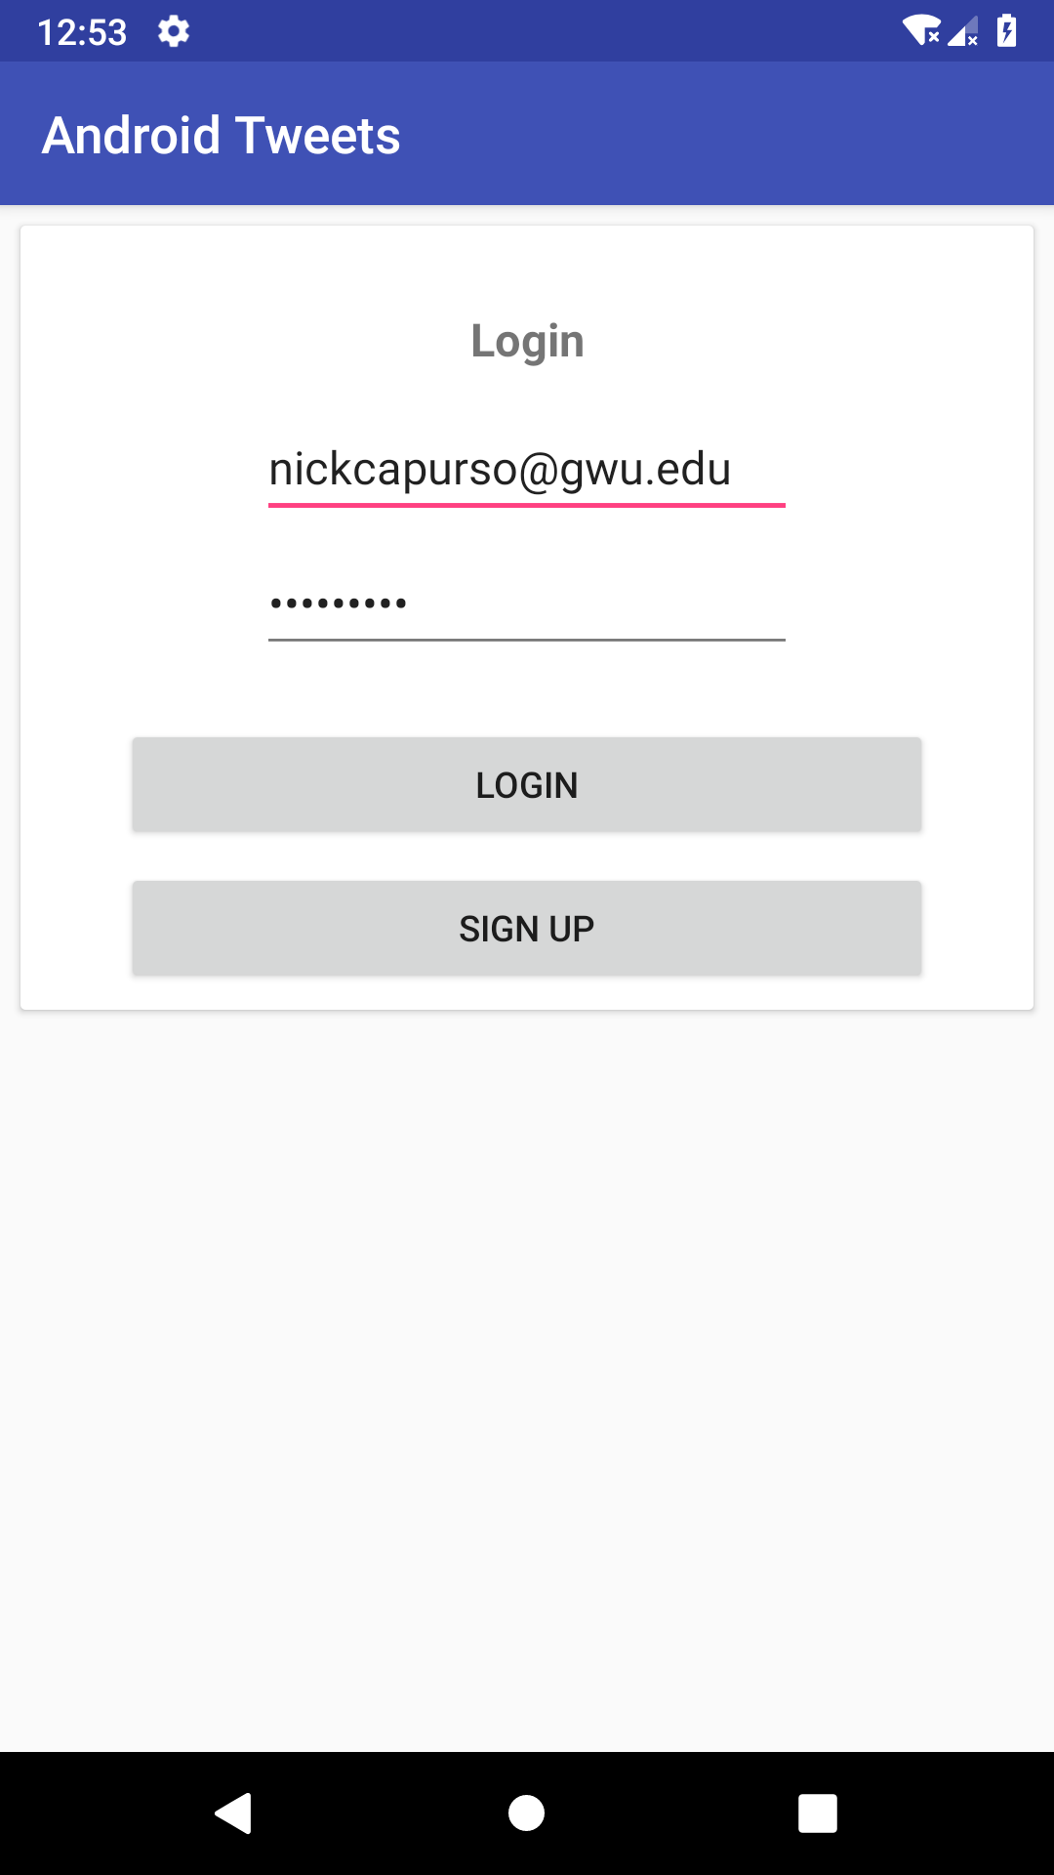
Sign Up
Now we’re ready to actually write some code.
We don’t have any user accounts created, so we need to update our Login screen to have a Sign Up button.
Users will supply email / password.

Slide 49
Sign Up
For Project 2, you’ll have a dedicated Sign Up screen (where the user also has to type their password twice).

Slide 50
Sign Up
For Project 2, you’ll have a dedicated Sign Up screen (where the user also has to type their password twice).
For the sake of time, Yelp Sign Up button will just register with the username / password inputted.

Slide 51
Sign Up
First, get an instance of the Authentication SDK in our LoginActivity.
// lateinit because Firebase recommends initializing in onCreate
private lateinit var firebaseAuth: FirebaseAuth
override fun onCreate(savedInstanceState: Bundle?) {
super.onCreate(savedInstanceState)
setContentView(R.layout.activity_login)
firebaseAuth = FirebaseAuth.getInstance()

Slide 52
Sign Up
Then, just call createUserWithEmailAndPassword to create a new user account! Firebase takes care of the rest!
signUpButton.setOnClickListener {
val inputtedUsername: String = username.text.toString().trim()
val inputtedPassword: String = password.text.toString().trim()
firebaseAuth.createUserWithEmailAndPassword(
inputtedUsername,inputtedPassword)
}

Slide 53
Sign Up
You can add a OnCompleteListener to be notified the registration was a success or failure using a “Task” object.
firebaseAuth
.createUserWithEmailAndPassword(...).addOnCompleteListener { task ->
if (task.isSuccessful) {
val user = firebaseAuth.currentUser
Toast.makeText(..., "Created user: ${user!!.email}",...).show()
} else {
val exception = task.exception
Toast.makeText(..., "Failed: $exception", ...).show()
}
}

Slide 54
Sign Up
You can call currentUser on your Firebase Auth instance to get the currently logged-in user.
firebaseAuth
.createUserWithEmailAndPassword(...).addOnCompleteListener { task ->
if (task.isSuccessful) {
val user = firebaseAuth.currentUser
Toast.makeText(..., "Created user: ${user!!.email}",...).show()
} else {
val exception = task.exception
Toast.makeText(..., "Failed: $exception", ...).show()
}
}

Slide 55
Sign Up
Note -- this does not do any sort of email verification. However, you can add code to do this.
firebaseAuth
.createUserWithEmailAndPassword(...).addOnCompleteListener { task ->
if (task.isSuccessful) {
val user = firebaseAuth.currentUser
user?.sendEmailVerification()
// ...
}

Slide 56
Sign Up
You can also add another OnCompleteListener to make sure the email was successfully sent by Firebase.
firebaseAuth
.createUserWithEmailAndPassword(...).addOnCompleteListener { task ->
if (task.isSuccessful) {
val user = firebaseAuth.currentUser
user?.sendEmailVerification().addOnCompleteListener { ...
// ...
}

Slide 57
Sign Up
And, you can check at a later time if the user has verified their email (for example, to prevent logging in).
if (user.isEmailVerified) {
// Do some more privileged action
}

Slide 58
Sign Up
If there is a failure, you can check the type of Exception to display custom error messages.
if (exception is FirebaseAuthInvalidCredentialsException) {
// The user’s username is formatted incorrectly
// or their password doesn’t meet minimum requirements
} else {
// Show generic error message
}

Slide 59
Sign Up
More info on managing users: https://firebase.google.com/docs/auth/android/manage-users
Password reset emails
Change password
Retrieve user profile info
Delete a user

Slide 60
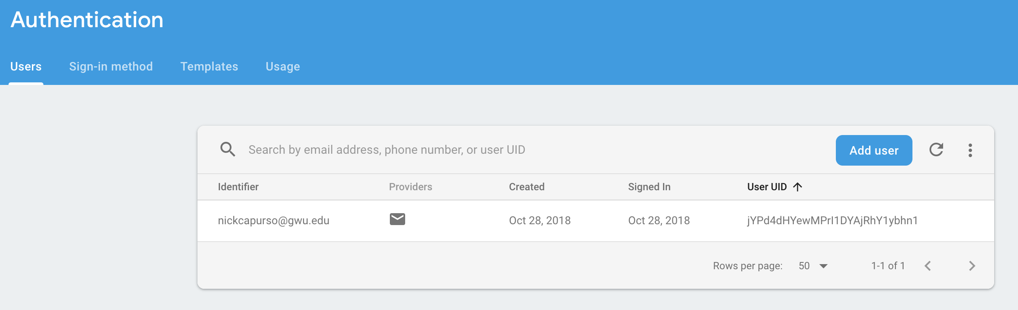
Sign Up
You can view your registered users on the dashboard.

Slide 61
Login
Logging in a user is very similar to signing them up. Of course, your user must have registered beforehand.
loginButton.setOnClickListener {
val inputtedUsername = username.text.toString().trim()
val inputtedPassword = password.text.toString().trim()
firebaseAuth.signInWithEmailAndPassword(inputtedUsername, inputtedPassword)
.addOnCompleteListener { task ->
if (task.isSuccessful) {
val user = firebaseAuth.currentUser
Toast.makeText(this, "Logged in as user: ${user!!.email}", Toast.LENGTH_SHORT).show()
// Go to the next Activity ...
} else {
val exception = task.exception
Toast.makeText(this, "Failed: $exception", Toast.LENGTH_SHORT).show()
}
}
}

Slide 62
Login
You can also add separate Success and Failure listeners. The Failure listeners give you an Exception, which you can use for error messages.
firebaseAuth.signInWithEmailAndPassword(username, password)
.addOnSuccessListener { result ->
// Sign in succeeded
}.addOnFailureListener { exception ->
// Sign in failed
}

Slide 63
Login
If there is a failure, you can check the type of Exception to display custom error messages.
if (exception is FirebaseAuthInvalidCredentialsException) {
Toast.makeText(..., "Invalid credentials, try again", ...).show()
} else if(exception is FirebaseAuthInvalidUserException) {
Toast.makeText(..., "We don't recognize that username, want to register?", ...).show()
} else {
Toast.makeText(..., "Failed: $exception", ...).show()
}

Slide 64
Login
private lateinit var firebaseAuth: FirebaseAuth
override fun onCreate(savedInstanceState: Bundle?) {
super.onCreate(savedInstanceState)
setContentView(R.layout.activity_choose_location)
firebaseAuth = FirebaseAuth.getInstance()
val currentUser = firebaseAuth.currentUser
val username = currentUser?.email ?: "User"
title = getString(R.string.welcome_name, username)

Slide 65
Login
We can also show / hide our ProgressBar (and potentially even disable buttons / input) while Firebase is logging the user in or signing them up.

Slide 66
Login
Once logged in, the Firebase SDK will “remember” the user and they will still be logged in the next time the user launches the app. So you could skip the login screen.
override fun onStart() {
super.onStart()
// If the user is already logged in, send them directly to the Maps Activity
if (firebaseAuth.currentUser != null) {
val user = firebaseAuth.currentUser
Toast.makeText(this, "Logged in as user: ${user!!.email}",
Toast.LENGTH_SHORT).show()
val intent = Intent(this, MapsActivity::class.java)
startActivity(intent)
}
}

Slide 67
Login
Once logged in, the Firebase SDK will “remember” the user and they will still be logged in the next time the user launches the app. You can call signOut() to log them out.
firebaseAuth.signOut()

Slide 68
Login
Some operations (e.g. deleting the user’s account or modifying their profile), may require the user to have logged in (or been prompted to re-login) recently.

Slide 69

Login
We can update our MapsActivity to use the user’s email name.
We can grab it from Firebase, no need to pass it between activities.

Slide 70
Firebase Realtime Database

Slide 71
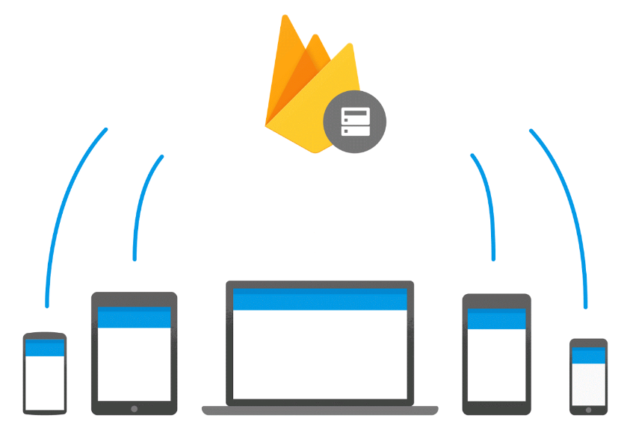
Firebase Database
Firebase Realtime Database is a feature where client apps can push data to a database and the changes are automatically and immediately pushed out to all listening apps.

Slide 72

Firebase Database
Useful for:
Sharing information across devices.
Content which can change dynamically.
Simple communication.
Post / comment systems.

Slide 73
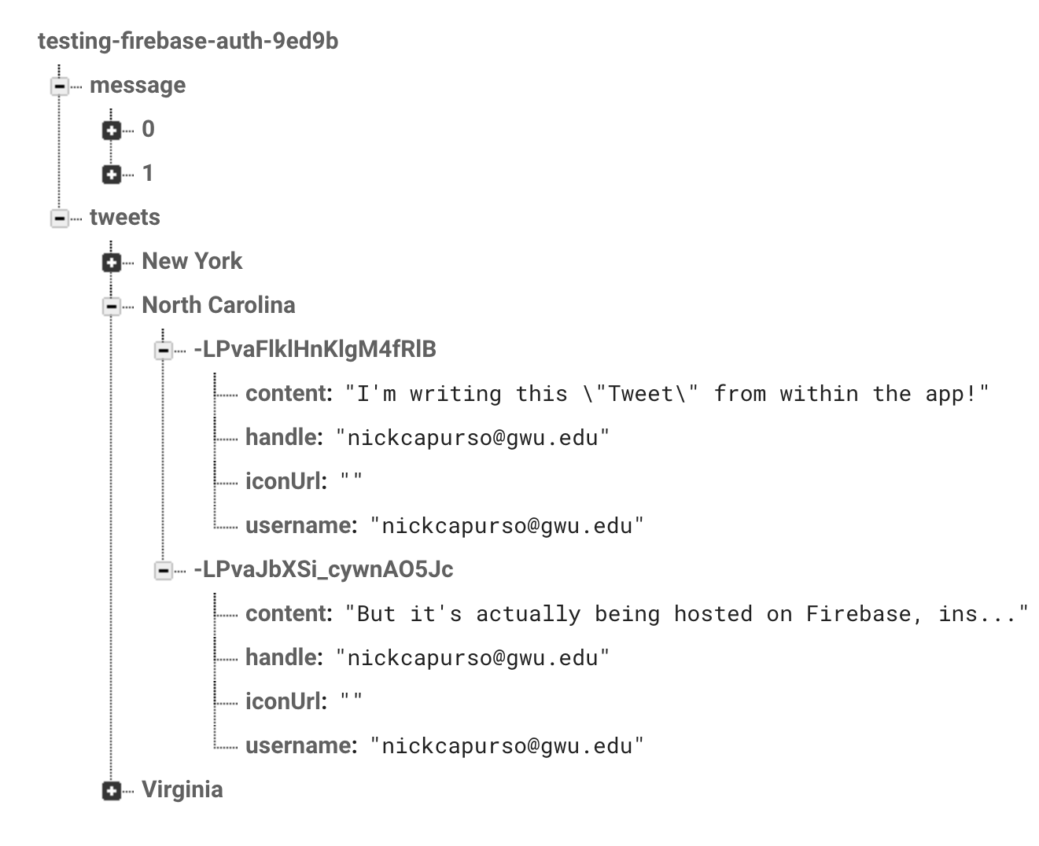
Firebase Database
Instead of being SQL-based with tables, Firebase’s database are JSON based.

Slide 74
Firebase Database
Let’s update the YelpApp to point to Firebase instead of Yelp.

Slide 75
Firebase Database
We’ll have “tables”, based on which state the user selects on the Map.
“Yelps” can be written and posted to that state in the database.

Slide 76
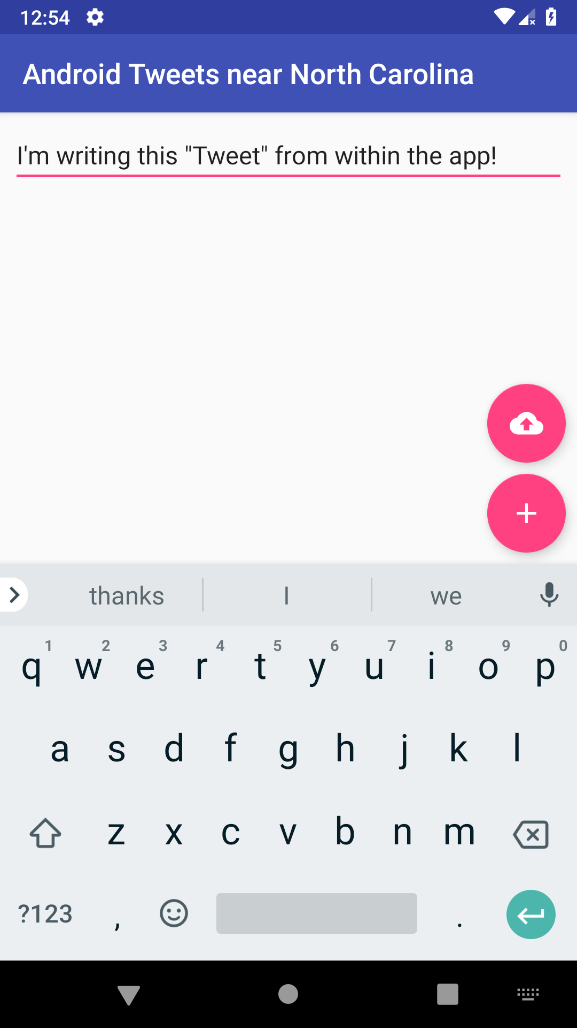
Writing to your Firebase Database
Let’s add an EditText and a submission button to our YelpListing Activity.

Slide 77
Writing to your Firebase Database
The rounded button is called a “FloatingActionButton” (FAB), which works like an ImageButton.
// Part of the Design library
implementation 'com.google.android.material:material:1.5.0'

Slide 78
Writing to your Firebase Database
<?xml version="1.0" encoding="utf-8"?>
<androidx.constraintlayout.widget.ConstraintLayout xmlns:android="http://schemas.android.com/apk/res/android"
xmlns:app="http://schemas.android.com/apk/res-auto"
xmlns:tools="http://schemas.android.com/tools"
android:layout_width="match_parent"
android:layout_height="match_parent">
<EditText
android:id="@+id/editText"
android:layout_width="0dp"
android:layout_height="wrap_content"
android:ems="10"
android:inputType="textPersonName"
android:text="Name"
app:layout_constraintEnd_toEndOf="parent"
app:layout_constraintStart_toStartOf="parent"
app:layout_constraintTop_toTopOf="parent" />
<androidx.recyclerview.widget.RecyclerView
android:id="@+id/recyclerView"
android:layout_width="0dp"
android:layout_height="0dp"
app:layout_constraintBottom_toBottomOf="parent"
app:layout_constraintEnd_toEndOf="parent"
app:layout_constraintHorizontal_bias="0.0"
app:layout_constraintStart_toStartOf="parent"
app:layout_constraintTop_toBottomOf="@+id/editText" />
<com.google.android.material.floatingactionbutton.FloatingActionButton
android:id="@+id/add_tweet"
android:layout_width="wrap_content"
android:layout_height="wrap_content"
android:layout_margin="8dp"
android:clickable="true"
app:layout_constraintBottom_toBottomOf="parent"
app:layout_constraintEnd_toEndOf="parent"
app:srcCompat="@drawable/ic_add_white"
app:useCompatPadding="true" />
</androidx.constraintlayout.widget.ConstraintLayout>

Slide 79
Questions?

Slide 80
Project 2
Project 2’s write-up is now available for you to read.
Proposal Due 3/26: tell me what you want to work on.
Loose requirements:
Must include a Sign In & Sign Up screens plus two other Activities.
Must include two “complexities”: API calls, use of Google / Firebase SDKs, permissions, hardware sensors, etc.
Must support English plus one other language.
I can be somewhat flexible on requirements if you have something that’s reasonably complex, but not covered by the requirements.

Slide 81
Project 2
Two paths:
Come up with your own idea for a new app project.
Does not have to be original - just something small you’d be interested in building.
Extend your Project 1 app.
Assumes you (or your partner) have a working Project 1 app to extend.
Only the “new” content is subject for grading.
Same requirements (need to add Sign In / Sign Up, two complexities, 2nd language, etc.).

Slide 82
Project 2
I’d encourage you to work on a new app, even if you don’t think your idea is “good” or “practical”.
Gets you a 2nd Android app under your belt or to put into your GitHub portfolio after the semester.

Slide 83
Project 2 Proposal
Due 3/26- short write-up of your idea:
Whether you will create a new app or extend Project 1.
A few sentences describing your project idea.
A description of what your extra screens will be.
Links to the specific API(s) and/or complexities you plan to use.

Slide 84
Project 2
Due 10/31 - short write-up of your idea:
I need to be able to tell exactly what your extra activities will be and what your two complexities are.
e.g. don’t just write “We’ll use some of Yelp’s APIs to do X” - I need to know which exact Yelp API(s) you plan to use.
The goal is ensure you have reviewed the APIs / complexities and confirmed that the data / functionality you need is available.

Slide 85
Project 2
IMPORTANT: If applicable, create a developer account for the APIs you plan to use and confirm that you receive an API Key / Secret - try your APIs out in Postman!
Make sure the APIs are “free” (e.g. not a trial) or for a reasonable amount of use.
You are responsible for choosing reliable APIs for your project.

Slide 86
Key Dates
4/6: Check in 1
4/23: Presentation and demo (does not have to be 100% complete but close)
4/30: Final Turn-in
No Check-in 2

Slide 87
Helpful Links
Firebase
Products
Example Use Cases
Pricing

Slide 88
Helpful Links
Firebase Authentication
Intro
Prebuilt UI SDK
Email / Password Login & Sign Up
User Management

Slide 89
Helpful Links
Firebase Database
Intro
Basics
JSON Structuring
Reading / Writing
Working with Lists
Configuring Security Rules

